Slide 1
Improving Your Exam Result
The art of exam technique

Slide 2
Doing well in exams
Part of a successful exam performance is due to what you know
The other part is due to how you do it
This second point is called your exam technique. Like all skills, it improves with practice

Slide 3
Exam technique – what is it?
Exam technique can be divided into two parts:
Before the exam
During the exam
During the exam can be divided into two parts:
During reading time
During working time

Slide 4
Before the exam
Night before:
Read over your notes once then go to bed (avoid retroactive interference)
Have a relatively early night – sleep!
Mobile phone away!!!
Morning of:
Eat!
even if you don’t want to. You will be distracted if 1 hour into your stomach starts rumbling and people keep staring at you
brain foods (i.e. slow energy release foods): bananas are ideal, as are porridge, milk, yoghurt…
Drink:
mild stimulants: a weak coffee
Remember, an exam is a marathon not a sprint – NO REDBULL!
At school:
Avoid nervous friends
Sit quietly by yourself and prepare yourself mentally
DO NOT engage in conversations with other students about what you or they did or did not study. This is NEVER productive!!!

Slide 5

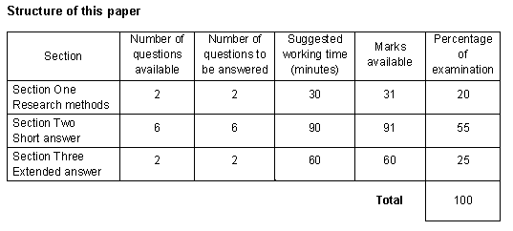
During the exam – reading time
Use the full 10 minutes: avoid reading the exam once and then zoning out for the remaining time
Identify which question you will do first: this should be a question you know the answer to and will give you a nice confidence boost going into the remainder of the exam
Start considering which short answer questions (Section 2) are relevant to the extended answer question (Section 3)

Slide 6
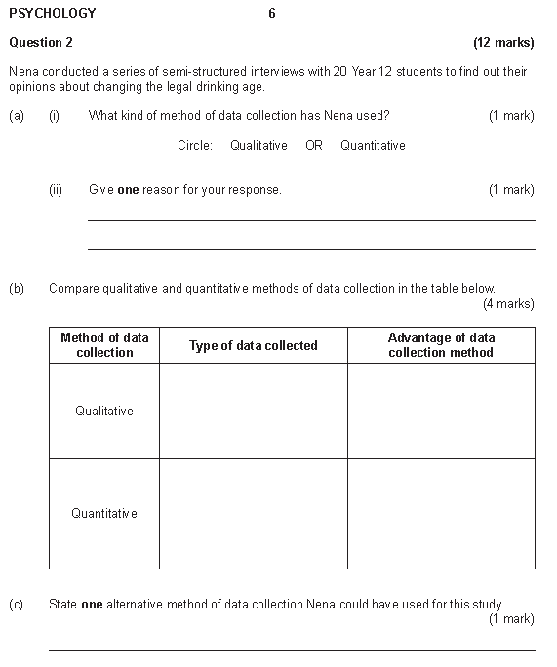
During the exam – working time
Plan - use key words in the margin: as soon as you start working your brain starts getting tireder. Recognition is easier than recall. A tired brain 2 hours into an exam may not be able to recall a correct answer, but may be able to recognise the answer from a keyword in the margin

Slide 7
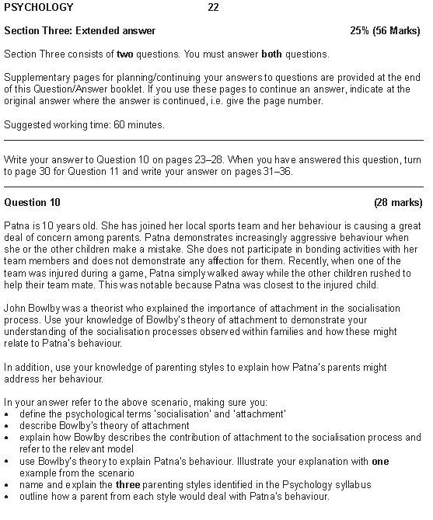
During the exam – working time
Plan - your extended response: this is Section 3 of the exam, and usually the question students attempt last. Two hours into the exam your brain will be fatiguing, and a plan will assist you with structuring and writing your response. If you try to plan your response two hours into the exam, there will be information you will forget to include compared to if you had planned your response at the start of your working time.
Revise your extended response plan at the end of each short answer question: ask yourself: what questions have I answered with information that is also relevant and could be used to answer the extended response? Look for hints!

